Slide 1
ERASMUS FALL SEMESTER STUDY MOBILITY ORIENTATION MEETING
09.05.2024

Slide 2
You have been nominated to your placement school, i.e. you have been notified to the institution where you have been placed as a candidate.
You should receive an information mail from your partner institution. This information mail includes the application steps. Please check the web page (Erasmus/ International Office, Exchange, EU Office) of your host university.
What is the application deadline? Which documents are required for the application? Is the application online? Do the documents need to be mailed? Is a language certificate required? Is a Learning Agreement required? What are the courses you can take in the semester you are going? What are the dates of the academic semester? Is the dormitory application made through the University or individually?

Slide 3
Prepare the required documents and complete your application before the deadline. If you are applying for a dormitory, complete your application as early as possible.
If an English language certificate is required, you can submit your SFL result certificate.
Complete the required documents according to the information on the web page, not according to what you hear from your friends!
If the Learning Agreement is required at the application stage, be sure to prepare it with your Erasmus+ Departmental Coordinator. Erasmus+ Department Coordinator List is available on our website and in the attachments below the result announcement list.

Slide 4
Now you can start waiting for your acceptance letter. Be patient during this process.
Usually, applications are reviewed collectively after the deadline. Keep in mind that International Offices have a very heavy workload.
Check your Işık email regularly for information emails from the partner institution. If you do not receive an information e-mail and your acceptance letter has not arrived less than 2 months before the start of the semester, please contact us!
After your acceptance letter arrives, please inform us and send your acceptance letter by email.

Slide 5
Visa Application and Before Mobility Documents
You can submit a copy of your acceptance letter to the International Office and you can take your visa support letter. The visa support letter states that you have been selected as an Erasmus student and the amount of the monthly grant you will receive.
Check the visa procedures of your destination country, make an appointment on time considering that the visa application result may take a long time and apply with the requested documents.
Do not forget to pay your tuition fee to Işık University during the Erasmus period. If you are a full scholarship student, you can submit your student certificate stating this.

Slide 6
Don't forget to complete the following documents and send them to us at least 3 weeks before your departure!
Note that you will not be able to receive your grant pre-mobility if the documents are not completed.
Copy of Learning Agreement
Original signed Course Transfer Table
Copy of Letter of Acceptance
Copy of Akbank Euro Passbook
Copy of the Student Health Insurance policy covering the period of stay
Işık University Tuition Fee Payment Receipt (Full Scholarship Certificate)
Student Learning Mobility Grant Agreement (It is sent to the student by e-mail after the student's visa is provided to the Office of the Registrar).

Slide 7
What is ECTS/ ECTS?
The European Credit Transfer System is an academic equivalence system whose main purpose is to ensure that the results of the courses taken by exchange students studying in educational institutions of different countries are mutually recognized by the relevant institutions as fairly as possible.
ECTS credit values of courses are calculated based on the workload for each course.
Generally, the ECTS equivalent of a 5-6 credit course at Işık University varies between 5-7.The course load of undergraduate students for a semester is accepted as 30 ECTS and it is one of the most basic principles of the Erasmus Program to take 30 ECTS courses corresponding to their own diploma programs in the semester of exchange.

Slide 8
What is a Learning Agreement - How to prepare one?
The Learning Agreement (LA) and the course transfer table are the guarantee that the courses you take at the other institution will count towards your Işık University course load upon your return! For this reason, the approval of the Erasmus Department Coordinator must be obtained at every stage of the LA.
The prepared LA document must be submitted to the International Office by the Erasmus Department Coordinators.
The LA basically consists of two parts: Before the Mobility - During the Mobility. The first part includes the courses you choose before you go abroad and the second part includes the course changes you make when you go abroad. The total credits of the courses you can take in your Learning Agreement must be at least 30 ECTS. This credit total also applies to the changes you make after your departure.

Slide 9
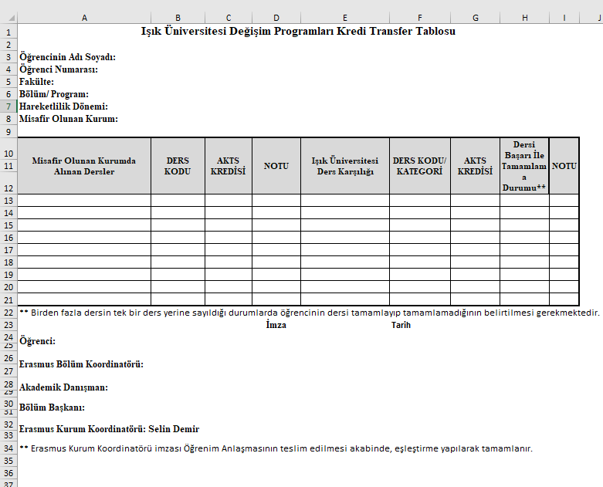
What is a Course Transfer Table - How to prepare one?

Slide 10
Course Changes
When you go abroad, you will realize that some of the courses you have chosen are not offered, are not suitable for your program or you do not want to take that course. In this case, you need to use the second part of your Learning Agreement, the add/delete (During Mobility) page.
You need to write the courses and credits you have given up taking and check the deleted box, write the courses and credits you have chosen and check the added box. (Always consult your department coordinator first)You do not need to write the courses that are on the first page of your LA document without any changes on the add/delete page again.
First have the counter institution sign the amended LA document you have prepared. Then email it to your Erasmus Department Coordinator for approval. The LA change must be made within 1 MONTH from the date of your arrival at the counter institution.

Slide 11
KEEP IN MIND!
Take out health insurance that is valid in your destination country.
Try to keep up with the orientation dates of the partner university.
If you will have a mentor, contact him/her in advance and get preliminary information about your welcome or meeting before you arrive.
If possible, try to arrange your accommodation before you go.
If your accommodation is a house and not a university dormitory, do not make any payments before you see the landlord.
Get information about your accommodation in advance.
Find out about the local transportation system and student discounts before you go. Try to get any international student cards that may be issued before you go.
Buy your ticket (after you receive the acceptance letter) as early as possible.

Slide 12
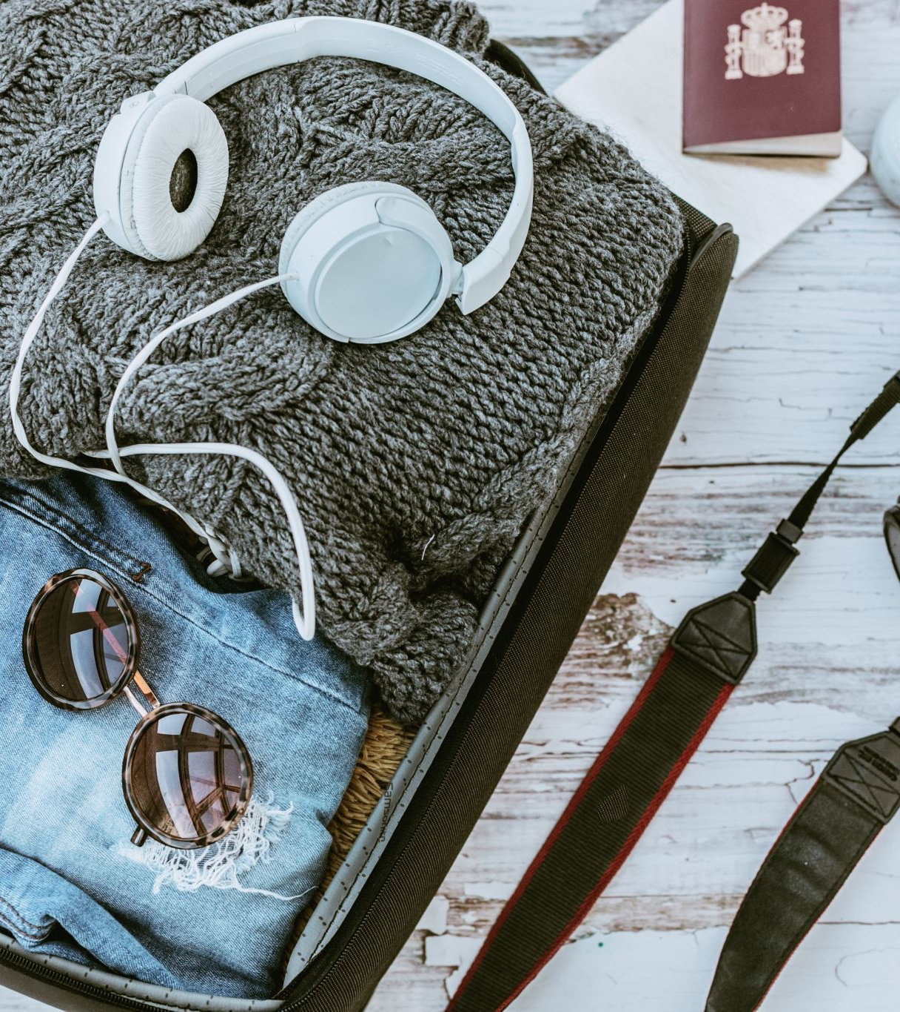
KEEP IN MIND!
Be aware of the electrical regulations of the country you are going to (especially to avoid problems with laptops and sockets)Watch your luggage weight!
Take extra passport photos with you.
Secure yourself financially. Your Erasmus grant may not be enough to cover all your expenses during your stay.
Contact Akbank and find out which ways you can withdraw the grant deposited in your account.
Don't leave it to the last minute to make sure your phone is switched on abroad.
Try to participate in extracurricular activities.
Be prepared for questions you may be asked as a student from Turkey.
Be prepared in advance for cultural differences specific to your destination country.

Slide 14
THANK YOU FOR LISTENING!
INTERNATIONAL RELATIONS DEPARTMENT
Sile Campus, Orange Dormitories H Block
Alp AKGÜLLÜ
Head of Department - Erasmus Institution Coordinator
Yaren CANİK - Senior Erasmus Programs Specialist
Derya KARTAL - Erasmus Programs Specialist
international@isikun.edu.tr

